Slide 1

Maximum & Minimum Applied
RCET 0264 Introductory Calculus
Tim Leishman

Slide 2
Maximum & Minimum
An open box is to be made from a square piece of aluminum 3cm on a side, by cutting squares from each corner and then folding up the sides. Determine the dimensions of the box that will have the largest volume.

Slide 3
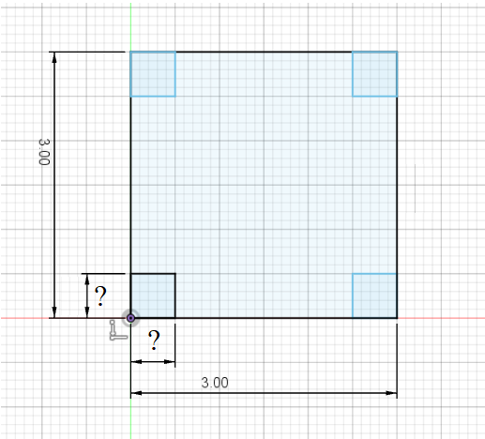
Maximum & Minimum
An open box is to be made from a square piece of aluminum 3cm on a side, by cutting squares from each corner and then folding up the sides. Determine the dimensions of the box that will have the largest volume.

Slide 4

Maximum & Minimum
An open box is to be made from a square piece of aluminum 3cm on a side, by cutting squares from each corner and then folding up the sides. Determine the dimensions of the box that will have the largest volume.
$Area =X×Y$
$Volume=X×Y×H$

Slide 5
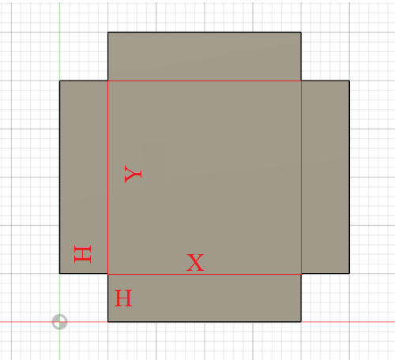
Maximum & Minimum
An open box is to be made from a square piece of aluminum 3cm on a side, by cutting squares from each corner and then folding up the sides. Determine the dimensions of the box that will have the largest volume.
$Area =X×Y$
$Volume=X×Y×H$

Slide 6
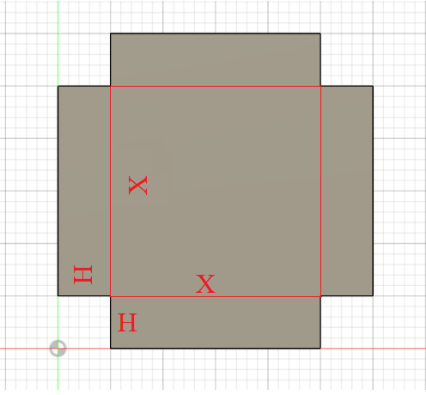

Maximum & Minimum
An open box is to be made from a square piece of aluminum 3cm on a side, by cutting squares from each corner and then folding up the sides. Determine the dimensions of the box that will have the largest volume.
$$Area =X×X$$
$Area=X^{2}$
$Volume=X^{2}×H$

Slide 7
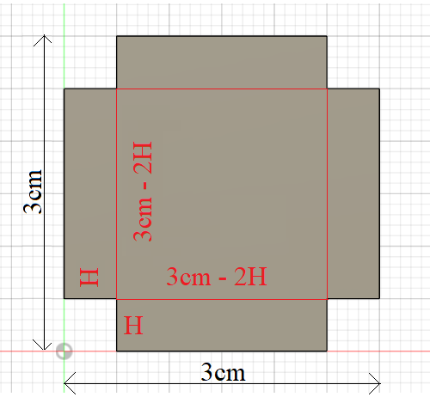

Maximum & Minimum
An open box is to be made from a square piece of aluminum 3cm on a side, by cutting squares from each corner and then folding up the sides. Determine the dimensions of the box that will have the largest volume.
In terms of H with original 3cm x 3cm dimension.
$$Area =X×X$$
$X=3cm −2H$
$Area={(3cm −2H)}^{2}$
$$Volume=X^{2}×H$$
$Volume={(3cm −2H)}^{2}×H$

Slide 8

Maximum & Minimum
An open box is to be made from a square piece of aluminum 3cm on a side, by cutting squares from each corner and then folding up the sides. Determine the dimensions of the box that will have the largest volume.
$$Volume={(3cm −2H)}^{2}×H$$
$V=(3cm−2H)(3cm−2H)(H)$
$V=\left(9cm−6H−6H+4H^{2}\right)\left(H\right)$
$V=\left(9cm−12H+4H^{2}\right)\left(H\right)$
$V=9H−12H^{2}+4H^{3}$

Slide 9
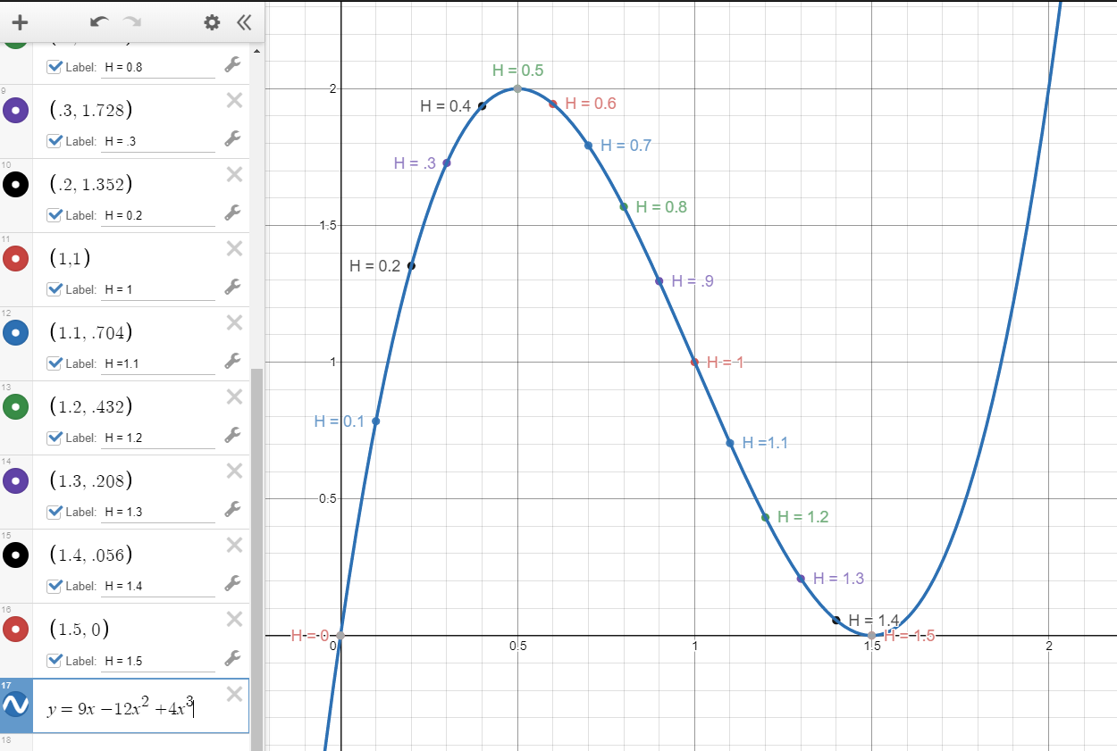

Maximum & Minimum
An open box is to be made from a square piece of aluminum 3cm on a side, by cutting squares from each corner and then folding up the sides. Determine the dimensions of the box that will have the largest volume.
$$Volume={(3cm −2H)}^{2}×H$$
$V=9H−12H^{2}+4H^{3}$

Slide 10

Maximum & Minimum
An open box is to be made from a square piece of aluminum 3cm on a side, by cutting squares from each corner and then folding up the sides. Determine the dimensions of the box that will have the largest volume.
$$Volume={(3cm −2H)}^{2}×H$$
$V=9H−12H^{2}+4H^{3}$
Calculus Solution:
$V=9H−12H^{2}+4H^{3}$
$\frac{dv}{dh}=9−24H+12H^{2}$
$0=9−24H+12H^{2}$
$12H^{2}−24H+9=0$
$H =0.5cm \& 1.5cm$
$H =0.5cm$

Slide 11
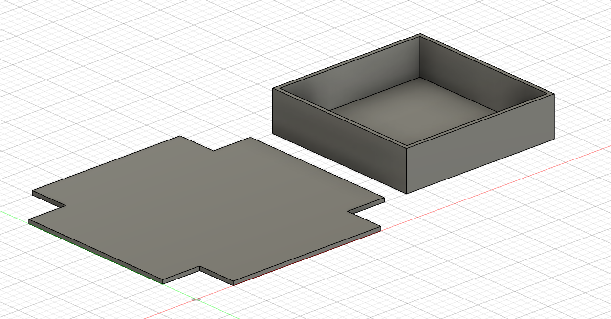

Maximum & Minimum
An open box is to be made from a square piece of aluminum 3cm on a side, by cutting squares from each corner and then folding up the sides. Determine the dimensions of the box that will have the largest volume.
$$H =0.5cm$$
$Area =X×Y$
$X=3cm−2H$
$X=3cm−2\left(0.5cm\right)$
$X=2cm$
$Y=2cm$
$Volume=X×Y×H$
$V=2cm×2cm ×0.5cm$
$V=2{cm}^{3}$

Slide 12
Maximum & Minimum
References:
Ewen, D., Gary, J. S., & Trefzger, J. E. (2005). Technical calculus. Upper Saddle River, NJ: Pearson/Prentice Hall.
https://www.desmos.com
https://www.autodesk.com/products/fusion-360/overview

